Slide 1
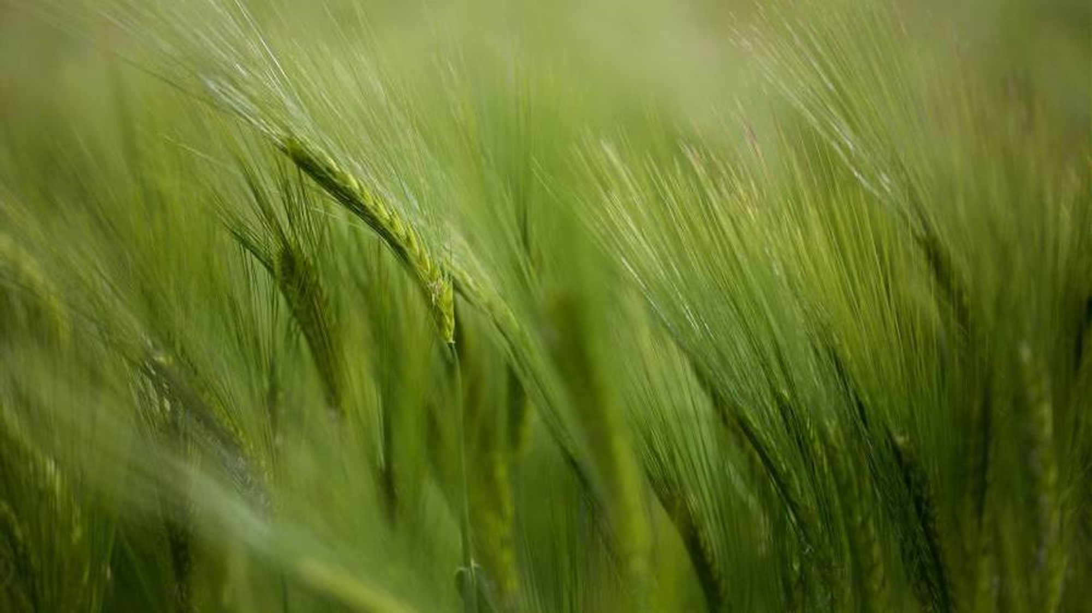
A take on Agricultural labor markets
North Valley Nut Conference
January 14, 2026
Greg Jones
Farmer | Economics Lecturer | Tehama County Supervisor

Slide 2
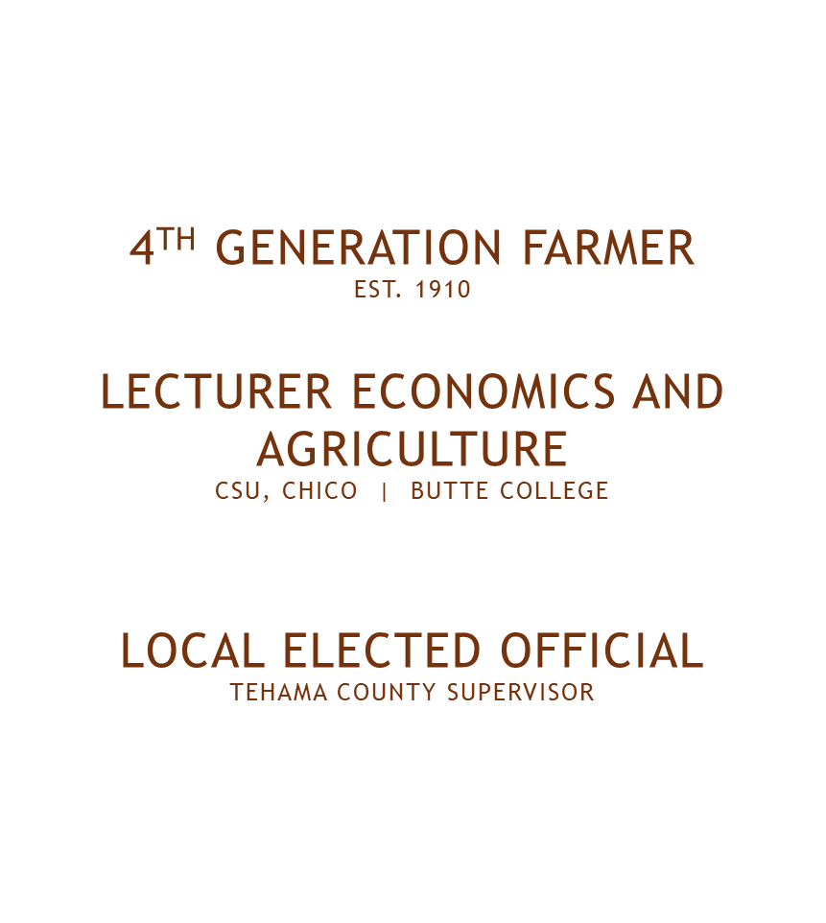
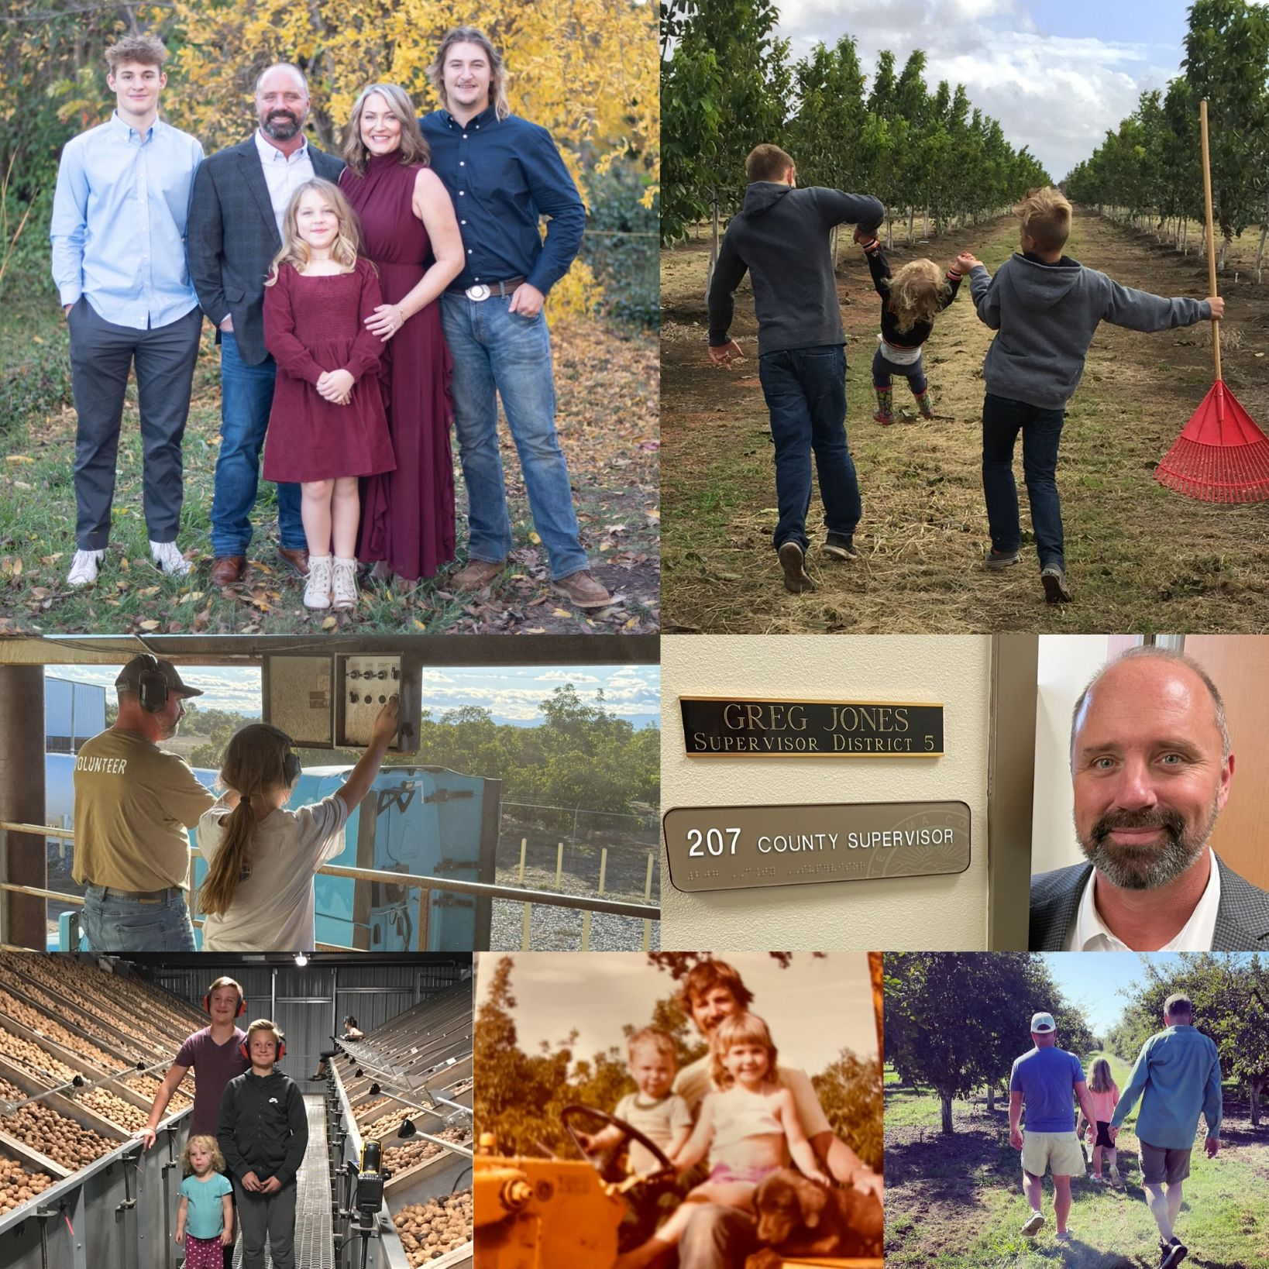

Slide 3
What comes to mind with industry leaders?
Concerns:
Rising costs tied to AB 1066 (change in overtime pay for agricultural workers)
Higher wages and compliance burdens
Increased uncertainty and risk in availability of workforce

Slide 4
Three Structural Realities
Labor scarcity is about wages and opportunity costs
Technology substitutes for labor
This is a reoccurring economic process

Slide 5

LABOR SCARCITY ≠ LACK OF WORKERS
George Borjas Framework
There is not a “shortage” of people willing to work—there is a shortage of native-born workers at market wages
Opportunity Costs are higher today — farm work is competing with modern labor markets
  Farm wages ≥ best alternative wage
Rising wages do not “fix” scarcity.
  Farm work remains seasonal, physical intense, and overtime unpredictable

Slide 6
When Labor Gets Risky, Capital Responds
What happens when labor becomes?
  Scarce
  Expensive
  Uncertain
  Capital substitutes for labor
    “It is not ideological, it’s arithmetic”
NOTEBLY it is these reasons why California has moved toward capital-intensive commodities (e.g. tree nuts, rice) and away from labor intensive commodities (e.g. stone fruits).
  Our Ricardian advantages have evolved over the past 50 years.

Slide 7
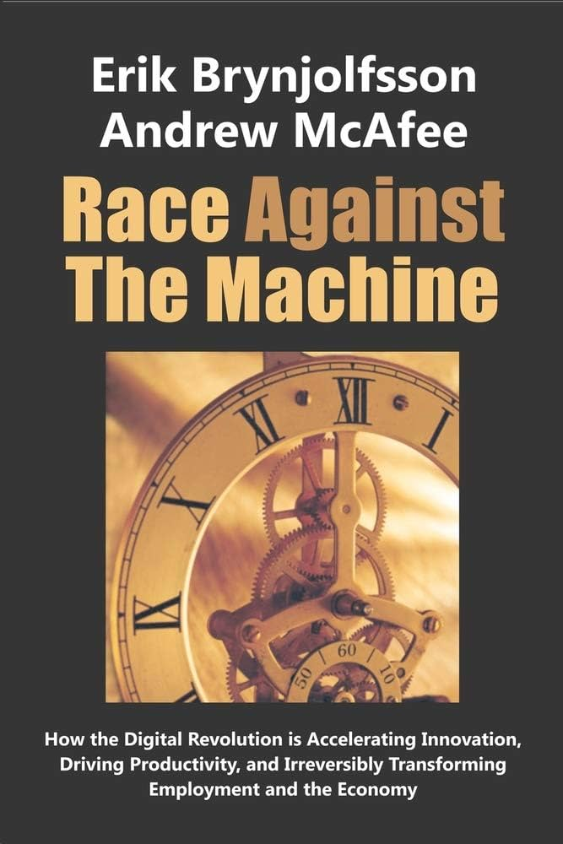
Technology Favors Scale
Automation has:
  High Fixed costs
  Low marginal costs
From the producer’s view:
  Capital must be paid for before harvest
  Labor risk is replaced with capital risk
  Under-utilized equipment is expensive

Slide 8
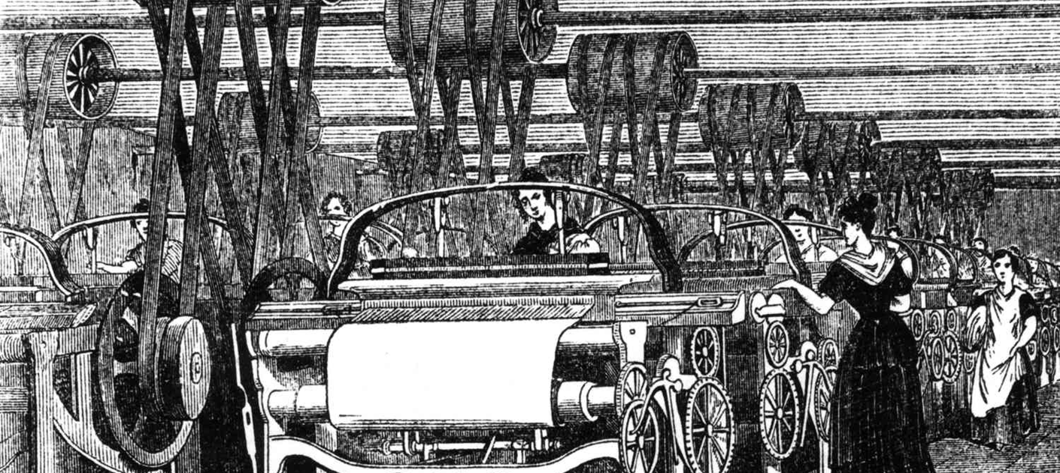
This Has Happened Before: The Luddites
Early 1800s textile workers:
Protested mechanization
Feared job loss & wage pressure
Outcome:
Higher productivity
Lower prices
Higher long-run incomes
This is a process of “creative destruction”, and the story repeats itself.

Slide 9
Why Agriculture Consolidates
When you combine:
  Wage-based labor scarcity
  Automation
  High Fixed Costs
Markets move toward:
  Larger, capital-intensive operations
  Contracting and specialization
  Fewer owner-operators
-This reflects equilibrium, not deliberate design-

Slide 10
The Real Policy Question:
How do we adapt?
Agricultural labor is moving toward:
Few workers per unit of output
Higher skill, higher use of capital
Greater Reliance on automation
This trajectory is:
Long-run
Market-driven
Largely irreversible

Slide 11
Policy?
Cost-sharing grants for equipment
Cooperative ownership models for high cost technology
Accelerated Depreciation

